Slide 1
Project Presentation Mathematics For Intelligent Systems - 3
Hand Recognition based Whiteboard with Handwritten Captioning
Team B2
Gowtham SD - CB.AI.U4AID23113 Guhan KB - CB.AI.U4AID23114 Jeevakamal KR - CB.AI.U4AID23115 Thippaluru Shatha Varsha Sree - CB.AI.U4AID23148

Slide 2
INTRODUCTION & OBJECTIVES
This project explores the integration of hand recognition technology with a digital whiteboard, allowing users to interact through natural hand gestures.
Innovative Interaction: Enables gesture-based interaction with a digital whiteboard.
Hand Gesture Recognition: Draw, erase, and clear with intuitive hand movements.
Real-time Handwritten Captioning: Converts handwritten text to editable digital content.
No Physical Tools: Eliminates the need for markers or erasers.
Practical Applications: Ideal for presentations, meetings, and educational settings.

Slide 3
METHODOLOGY
Draw
Using mediapipe ,able to track the hand movement along with the corresponding landmarks
Using the landmarks include certain gestures for writing , erasing etc
Convert
Takes the canvas drew by the user and sends it to a custom made OCR model
The Custom made OCR model converts the hand drawn text to a string
Display
The Canvas along with the String Caption generated is displayed to the user

Slide 4
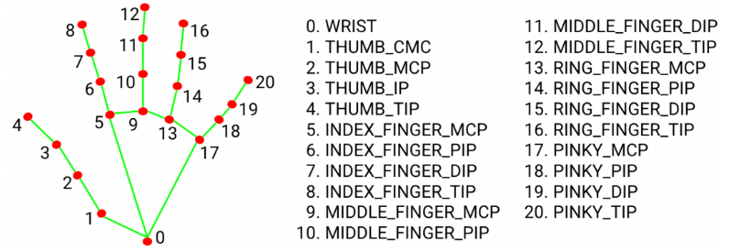
Methodology - Mediapipe
The Hand Landmark detection is done by Mediapipe.
The Position and orientation of the landmarks are used to determine the state of each finger.
Used to detect gestures for different actions based on different combinations of fingers opening and closing.

Slide 5
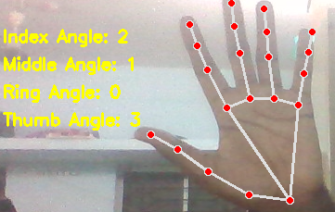

Methodology – Fingers (Open/Close)
To find whether finger is open/closed we find angle by which the finger bends
Angle is found using the base of the finger to the tip of the finger
Dot product is found and cos inverse is taken to determine the angle

Slide 6
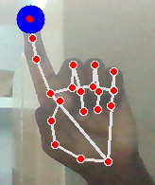
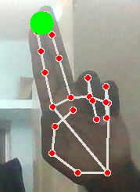
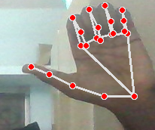
Methodology - Gestures
Draw Gesture : Starts Drawing form the index finger only when index finger is open
Erase Gesture : Erase the drawing in the canvas when both index and middle finger is open
Clear Canvas : Clear canvas only when thumb is open
Drawing , Erasing , Clear Canvas - Gestures

Slide 7
Methodology - OCR
The User’s Handwritten input is sent to a custom trained CNN mode to perform OCR (Optical Character Recognition).
Input data - (32, 32, 1) — grayscale images of size 32x32
Output – 35 classes (Alpha numericals [0-9,A-Z])
Training data – 1,40,000 hand drawn characters.
Model Architecture :
4 convolutional layers (Conv2D) & Pooling for each Convolution Layer
2 fully connected layers (Dense)

Slide 8
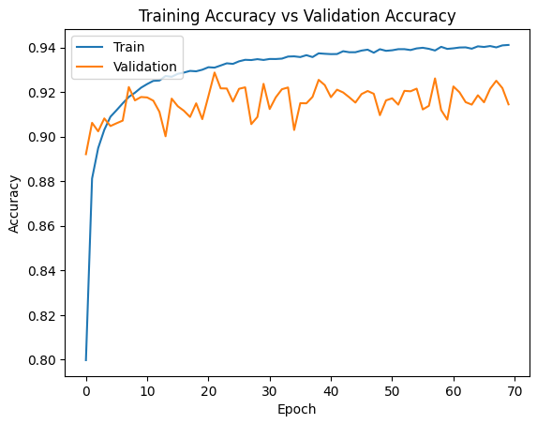
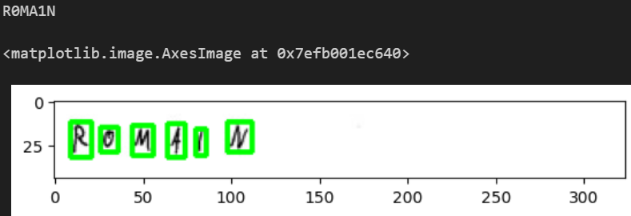
Methodology – OCR Training
Trained over 70 epochs to get the following results :
Training Accuracy – 0.94
Validation Accuracy – 0.915
The Model is able to predict the text well enough to transcript the input handwritten text.
Input
v/s
Output

Slide 9
Methodology – Final Steps
The output from the canvas is given as input to the OCR model.
Using the Sort Contours function we separate every single character.
The separated characters are then converted to 32 x 32 grayscale image for the model to process.
Again the recognised characters are concatenated together to reveal the output in a separate window.

Slide 10
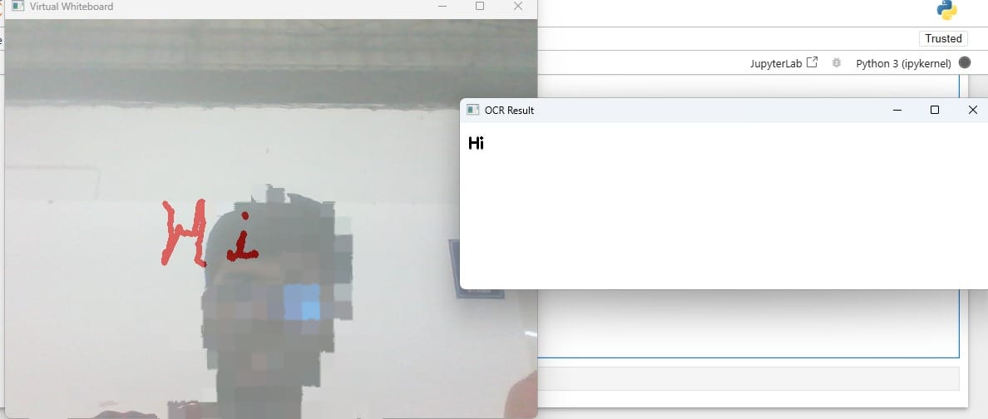
Output

Slide 11
Drawbacks/Improvements of the Software
Performance issues in lower/mid range systems even with threading.
The tilt of the hand causing inconsistencies with the gesture .
The Model doesn’t generalise/recognise normal use case words , thus sometimes fails to recognise words properly.
The input data often is much similar to multiple classes thus giving it further chance to make mistakes.

Slide 12
THANK YOU

